Slide 1
Power Management and Low Power Design for Embedded Processors (I)
Lecture 6

Slide 2
Outline
Embedded Processor
  Low Power Design Considerations
    RISC and code density
    Low power and power management
Embedded OS

Slide 3
Embedded Processor
Processor designed for embedded systems
  Application specific
  Special design and optimization
    Cost
    Features
    Pipeline stage
    RISC vs. CISC
    Clock rate
    Cache, register
    8-bit, 16-bit, 32-bit, …

Slide 4
Embedded Processor
  Special design and optimization (Cont.)
    Size
    Manufacturing
    Power consumption
    Instruction sets
    Support for software development
    Support for hardware extension
    ...

Slide 5
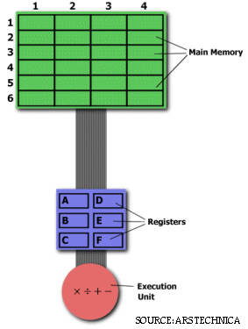
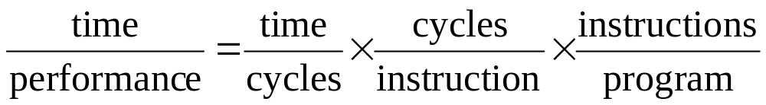
CISC vs. RISC
Let start by a simple multiplication example.
(2,3) = (2,3) x (5,2)
LOAD A, 2:3
LOAD B, 5:2
PROD A, B
STORE 2:3, A
MULT 2:3, 5:2
Notes:
CISC RISC
Emphasis on hardware Emphasis on software
Includes multi-clock complex instructions Single-clock, reduced instruction only
Memory-to-memory: "LOAD" and "STORE“ Register to register: "LOAD" and "STORE“ are
incorporated in instructions independent instructions
Small code sizes, high cycles per second Low cycles per second, large code sizes
Transistors used for storing complex instructions Spends more transistors on memory registers
These RISC "reduced instructions" require less transistors of hardware space than the complex instructions, leaving more room for general purpose registers. Because all of the instructions execute in a uniform amount of time (i.e. one clock), pipelining is possible.
The Performance Equation
The following equation is commonly used for expressing a computer's performance ability:
The CISC approach attempts to minimize the number of instructions per program, sacrificing the number of cycles per instruction. RISC does the opposite, reducing the cycles per instruction at the cost of the number of instructions per program.

Slide 6
CISC vs. RISC
CISC | RISC
Price/Performance Strategies
Price: move complexity from software to hardware. Performance: make tradeoffs in favor of decreased code size, at the expense of a higher CPI. | Price: move complexity from hardware to software Performance: make tradeoffs in favor of a lower CPI, at the expense of increased code size.
Notes:
http://arstechnica.com/cpu/4q99/risc-cisc/rvc-1.html

Slide 7
CISC vs. RISC
CISC | RISC
Design Decisions
A large and varied instruction set that includes simple, fast instructions for performing basic tasks, as well as complex, multi-cycle instructions that correspond to statements in an HLL. Support for HLLs is done in hardware. Memory-to-memory addressing modes. A microcode control unit. Spend fewer transistors on registers. | Simple, single-cycle instructions that perform only basic functions. Assembler instructions correspond to microcode instructions on a CISC machine. All HLL support is done in software. Simple addressing modes that allow only LOAD and STORE to access memory. All operations are register-to-register. Direct execution control unit. Spend more transistors on multiple banks of registers. Use pipelined execution to lower CPI.
CPI: cycle per instruction
HLL: High-Level Language

Slide 8
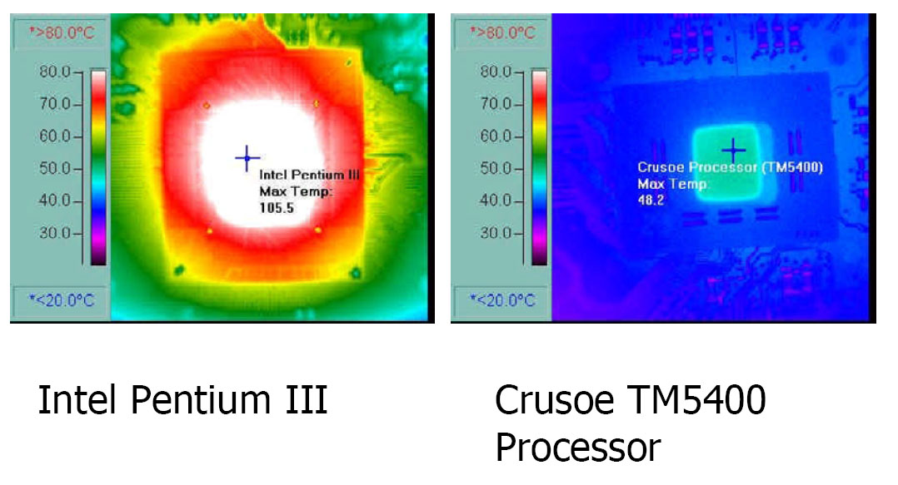
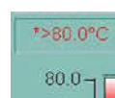
Thermal Comparison

Slide 9
RISC and code density
CISC or RISC
  RISC architecture
    Fixed instruction size
    Load-store architecture which process registers
    Larger register bank
  RISC organization
    Hard-wired instruction decode logic
    Single cycle execution
    Pipelined
  RISC advantages and disadvantages
    Advantages
      Small die size
      Shorter development time
      Higher performance
    Disadvantages
      Poor code density (code density = instructions/program)
      Can not execute x86 code
Notes:
Poor code density means that you need more memory to store the code.

Slide 10
Thumb Instruction Set at 1995
Thumb instruction set
  Better code density (70% of ARM’s)
  Compressed form of a subset of ARM instruction set
Thumb instruction set can handle most of C applications.
However, device drivers and exception handlers must often be written at least partly in ARM state.

Slide 11
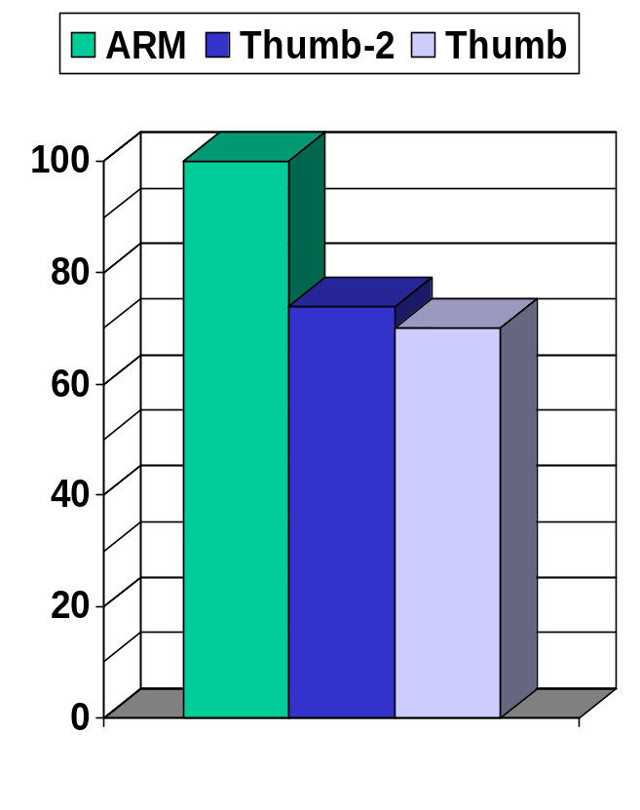
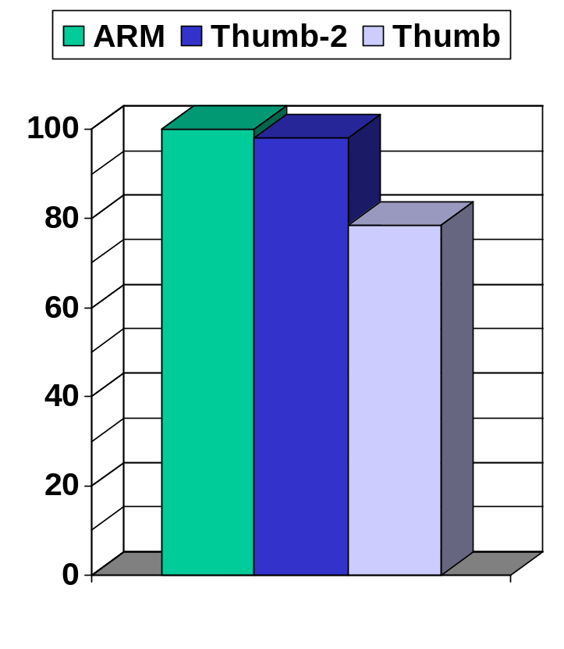
RISC and code density
Code Size
Performance
Thumb-2 Space Optimized 26% less than ARM.
Thumb-2 Performance Optimized 2% slower than ARM and 25% faster than Thumb.
http://www.arm.com

Slide 12
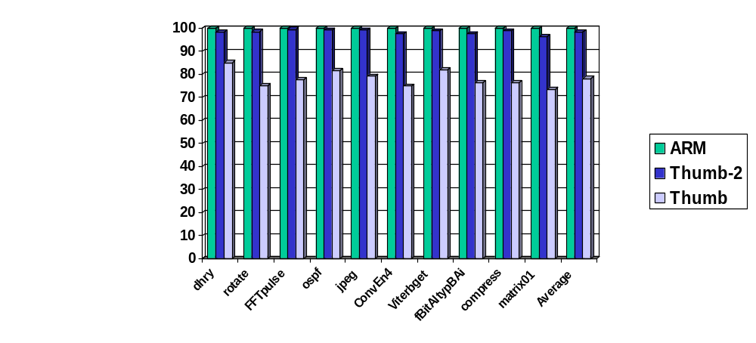
RISC and code density
Analysis of the performance of code for EEMBC* benchmarks on ARM11 like cores
  Thumb-2 performance is 98% of ARM performance
  Thumb-2 code achieves 125% of Thumb performance
* Uncertified EEMBC benchmarks based information showing relative performance ONLY
http://www.arm.com

Slide 13
RISC and code density
1.60
1.42
1.62
Thumb7
1.40
1.34
ARM7 / 9
1.22
1.20
Thumb9
M•CORE
C210
1.16
Thumb
Required Clocks
Relative To C•CORE M310
1.07
ARM
1.00
1.00
1.00
ARM7
0.93
Thumb7 / 9
C310
0.80
C210 / C310
ARM9
0.60
0.40
Code Density
Performance
Powerstone C-code Benchmark Suite; algorithms equally weighted and averaged - 9/99.
Compiled code optimized for code density. Performance measured in clock cycles.
Using latest available Compilers: Diab v4.3p7, ARM v2.5, Thumb v2.5
32-bit 1-clock memory.
http://www.electronicsletters.com/papers/2001/0003/paper.asp

Slide 14
RISC and code density
1.60
Better Code Density significantly improves
power consumption, runtime performance, and system cost
1.50
1.49
1.47
1.42
1.41
1.42
1.40
1.30
Your actual Thumb code density
falls in between.
Code Size Relative To C•CORE
1.20
1.10
1.07
Requires 50% more memory than C•CORE
Requires 42% more memory than C•CORE
Requires 49% more memory than C•CORE
Requires 41% more memory than C•CORE
Requires 47% more memory than C•CORE
1.00
1.00
Requires 7% more
memory than C•CORE
0.90
0.80
C•CORE
Thumb
(compressed
ARM)
ARM7
ARM9
StrongARM
V830
V850
SH2
SH3
NEC
Hitachi
Powerstone C-code Benchmark Suite; algorithms equally weighted and averaged - 9/99.
Compiled C code optimized for code density.
Compilers: Diab 4.3p7, ARM 2.5, Thumb 2.5, Green Hills 1.8, Hitachi 3.0F.
http://www.electronicsletters.com/papers/2001/0003/paper.asp

Slide 15
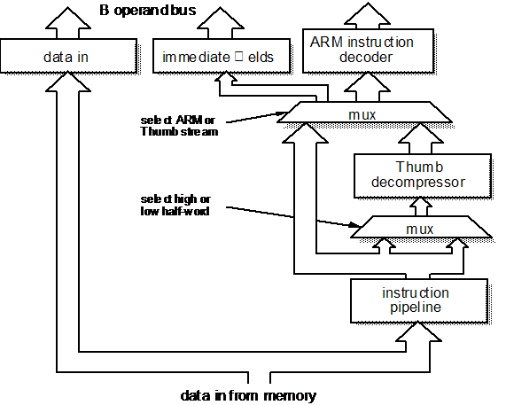
The Thumb instruction de-compressor organization
http://www.cs.man.ac.uk/apt/publications/books/ARMsysArch

Slide 16
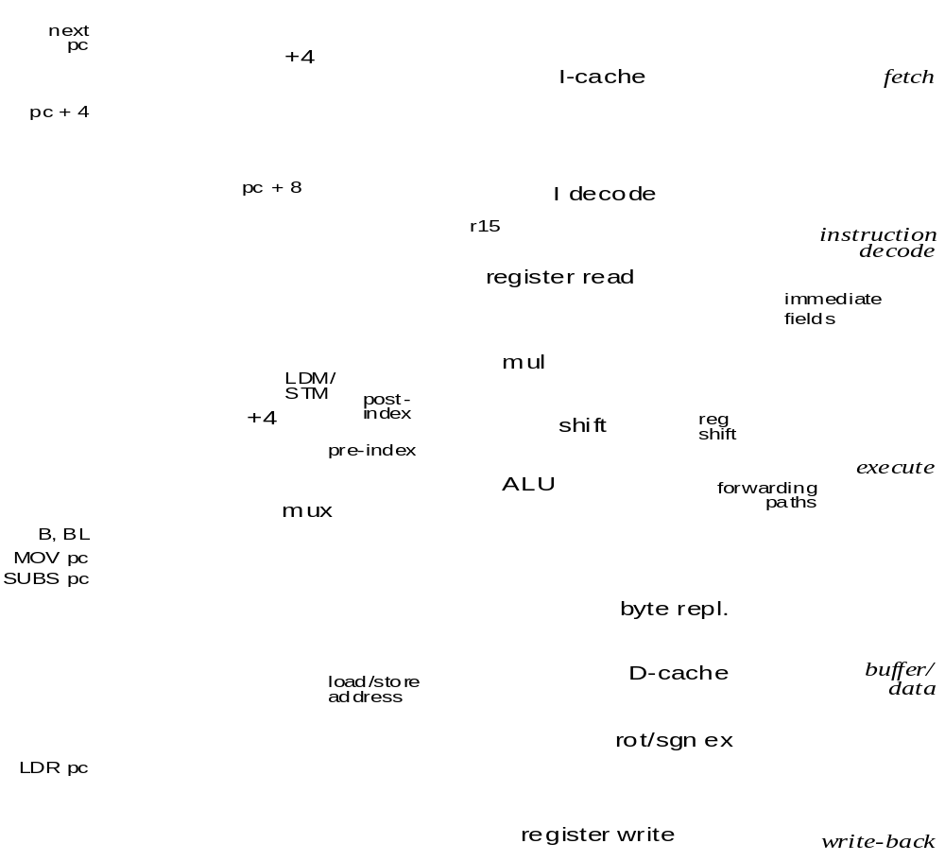
ARM9TDMI 5-stage pipeline organization
http://www.cs.man.ac.uk/apt/publications/books/ARMsysArch

Slide 17
RISC and code density
ARM design
  Thumb instruction set
  Compressed instruction sets
  Performance vs. code density
Performance issues
  Decode circuit
  Pipe line penalty

Slide 18
Thumb Instruction Set
Thumb instruction set
  High Code density
  Compressed form of a subset of ARM instruction set
Thumb instruction set can handle most of C applications.
However, device drivers and exception handlers must often be written at least partly in ARM state.

Slide 19
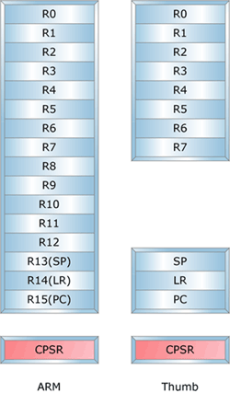
Programmer’s Models
Current Program Status Register (CPSR) shows the program model: ARM or Thumb.
Data can be passed using R0 to R7 between ARM and Thumb state.

Slide 20
Thumb entry and exit
From ARM mode to thumb mode
  Branch and exchange BX
  Exception return
From thumb mode to ARM mode
  Branch and exchange BX
  Exception entry (exception entry is always handled in ARM mode)

Slide 21
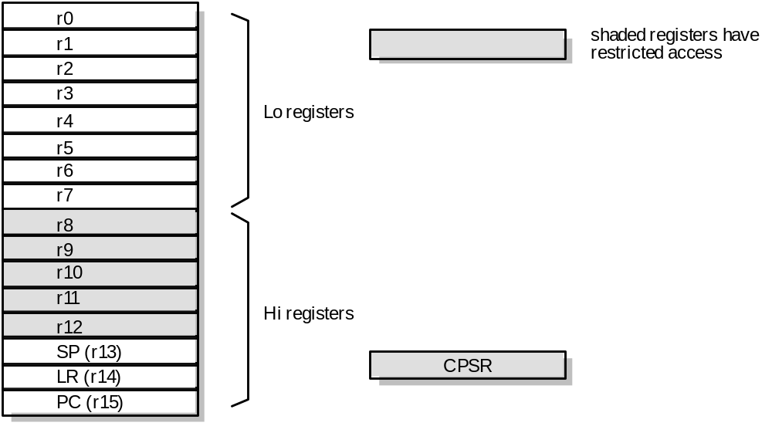
Thumb accessible registers

Slide 22
Thumb branch instruction binary encodings
15
12
11
8
7
0
1 1 0 1
cond
8-bit offset
(1)
B<cond> <label>
15
11
10
0
1 1 1 0 0
11-bit offset
(2)
B <label>
15
12
11
10
0
1 1 1 1
H
11-bit offset
(3)
BL <label>
15
11
10
1
0
1 1 1 0 1
10-bit offset
0
(3a)
BLX <label>
15
8
7
6
5
3
2
0
0 1 0 0 0 1 1 1
L
H
Rm
0 0 0
(4)
B{L}X Rm

Slide 23
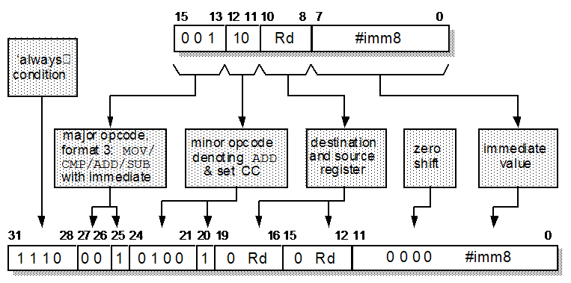
Thumb to ARM instruction mapping

Slide 24
Thumb applications
Thumb properties
  The thumb code requires 70% of the space of the ARM code
  The thumb code uses 40% more instructions than the ARM code
  With 32-bit memory, the ARM code is 40% fast than thumb code
  With 16-bit memory, the thumb code is 45% fast then the ARM code
  Thumb code uses 30% less external memory power than ARM code

Slide 25
Thumb applications
Performance is all important
  32 bit memory and ARM code
Cost and power consumption
  16 bit memory and thumb code
A high end 32-bit ARM system may use Thumb code for certain non-critical routine to save the power and memory
A low end 16-bit system may have a small amount of on-chip 32-bit RAM for critical routines running ARM code

Slide 26
Questions ?

